Slide 1
Forecasting Economic And Financial Time Series: ARIMA vs. LSTM
Teammates
Upamanyu Pathare
Yutao Shu
Yongsheng Liu
Hexin Xu
Bolun Deng

Slide 2
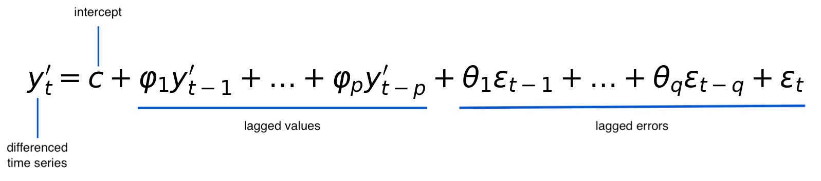
Introduction of the Paper: ARIMA vs LSTM(1)
By comparing the accuracy of ARIMA and LSTM, as representative techniques when forecasting time series data, this paper advocates the benefits of applying deep learning-based algorithms to the economics and financial data.
ARIMA(p,d,q): ARIMA(5,1,0) as the baseline to forecast

Slide 3
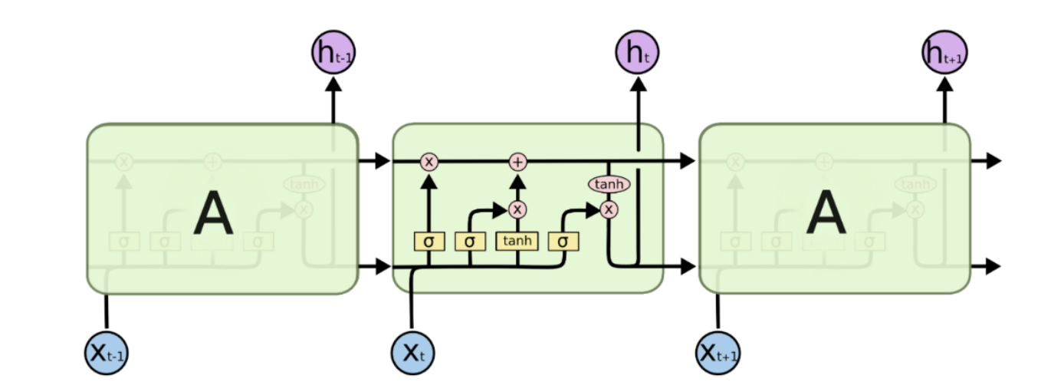
Introduction of the Paper: ARIMA vs LSTM(2)
RNN (Recurrent Neural Networks) are very powerful in handling the dependency among the input variables.
LSTM is a type of Recurrent Neural Network (RNN) that can hold and learn from long sequence of observations.
Each LSTM is a set of cells, in each of which data can be disposed, filtered, or added for the next cells with the use of gates.
In particular, three types of gates are involved in each cell: Forget Gate, Memory Gate, Output Gate.
The internal structure of an LSTM [Colah’s Blog, 2015]

Slide 4
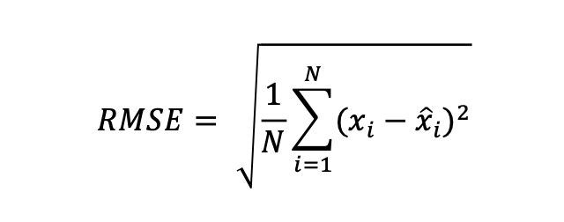
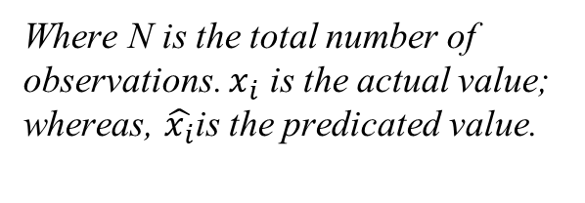
Introduction of the Paper: Metric of Performance
To assess the accuracy of prediction obtained by a model, RSME is used as the metric of performance, which is the square root of the average squared deviations from the true value.
It measures the differences or residuals between actual and predicated values.
Where N is the total number of observations. $x_{i}$ is the actual value; whereas, $\hat{x_{i}}$is the predicated value.

Slide 5
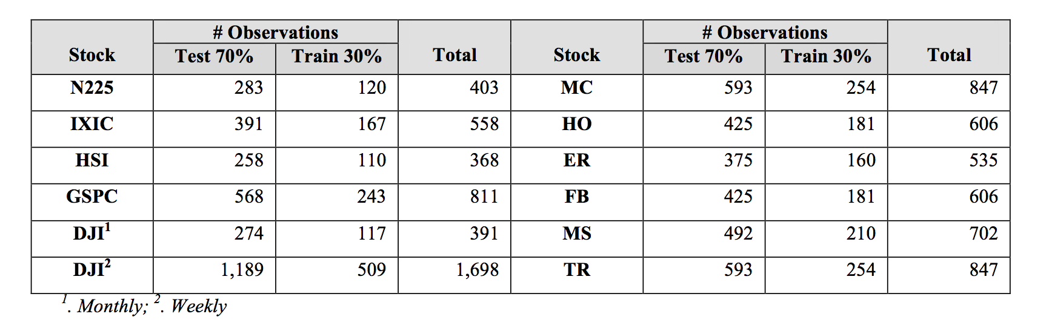
Introduction of the Paper: Data
Monthly financial data & economics data
Divided into training set vs. test set: 70% vs. 30%

Slide 6
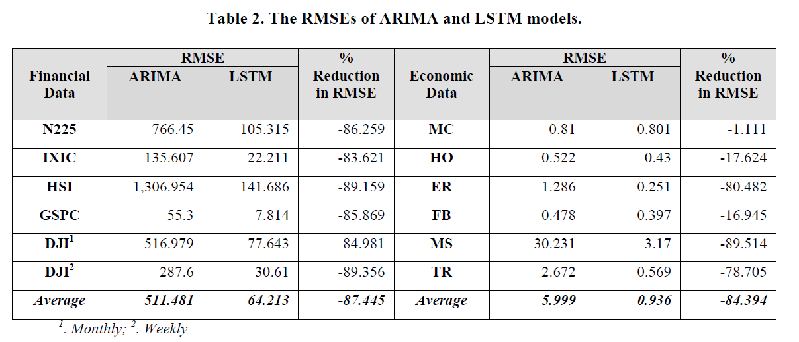
Introduction of the Paper: Result
Rolling ARIMA vs. Rolling LSTM

Slide 7
Introduction of the Paper: The Impact of Epoch
Epoch represents the total number of times a given dataset is used for training purposes.
It is often the case for deep learning methods that we train a network with the same training dataset more than once in order to optimize the parameters.
The authors performed a series of experiments with the epoch values varying between 1-100 for each dataset.
Results: there is no evidence that training the network with same dataset more than once would improve the accuracy of the prediction. In some cases, the performance even gets worse indicating that the trained models are being over-fitted.
Setting epoch = 1 does generate a reasonable prediction model.

Slide 8
Why this paper
The paper conducts an empirical study to analyze the performance of traditional forecasting techniques and deep learning-based algorithms.
The paper shows that LSTM outperforms ARIMA. The average reduction in error rates obtained by LSTM is between 84 - 87 percent when compared to ARIMA indicating the superiority of LSTM to ARIMA.
The paper shows that training LSTM model can be time-efficient since the number of training performed on data, has no effect on the performance of the trained forecast model.

Slide 9
Project pipeline
Extending the approach of the paper, we propose to apply the same techniques to other classes of time series, such as Forex and cryptocurrency.
For now, we will focus on GBP/USD, USD/JPY, and Bitcoin.
We will compare the performance of various specifications of ARIMA models with LSTM.
In particular we will experiment with various number of training epochs and training data set sizes.
If time permits we will also look into comparing the performance of the models during black-swan events like the current pandemic and other historical crises.

Slide 10
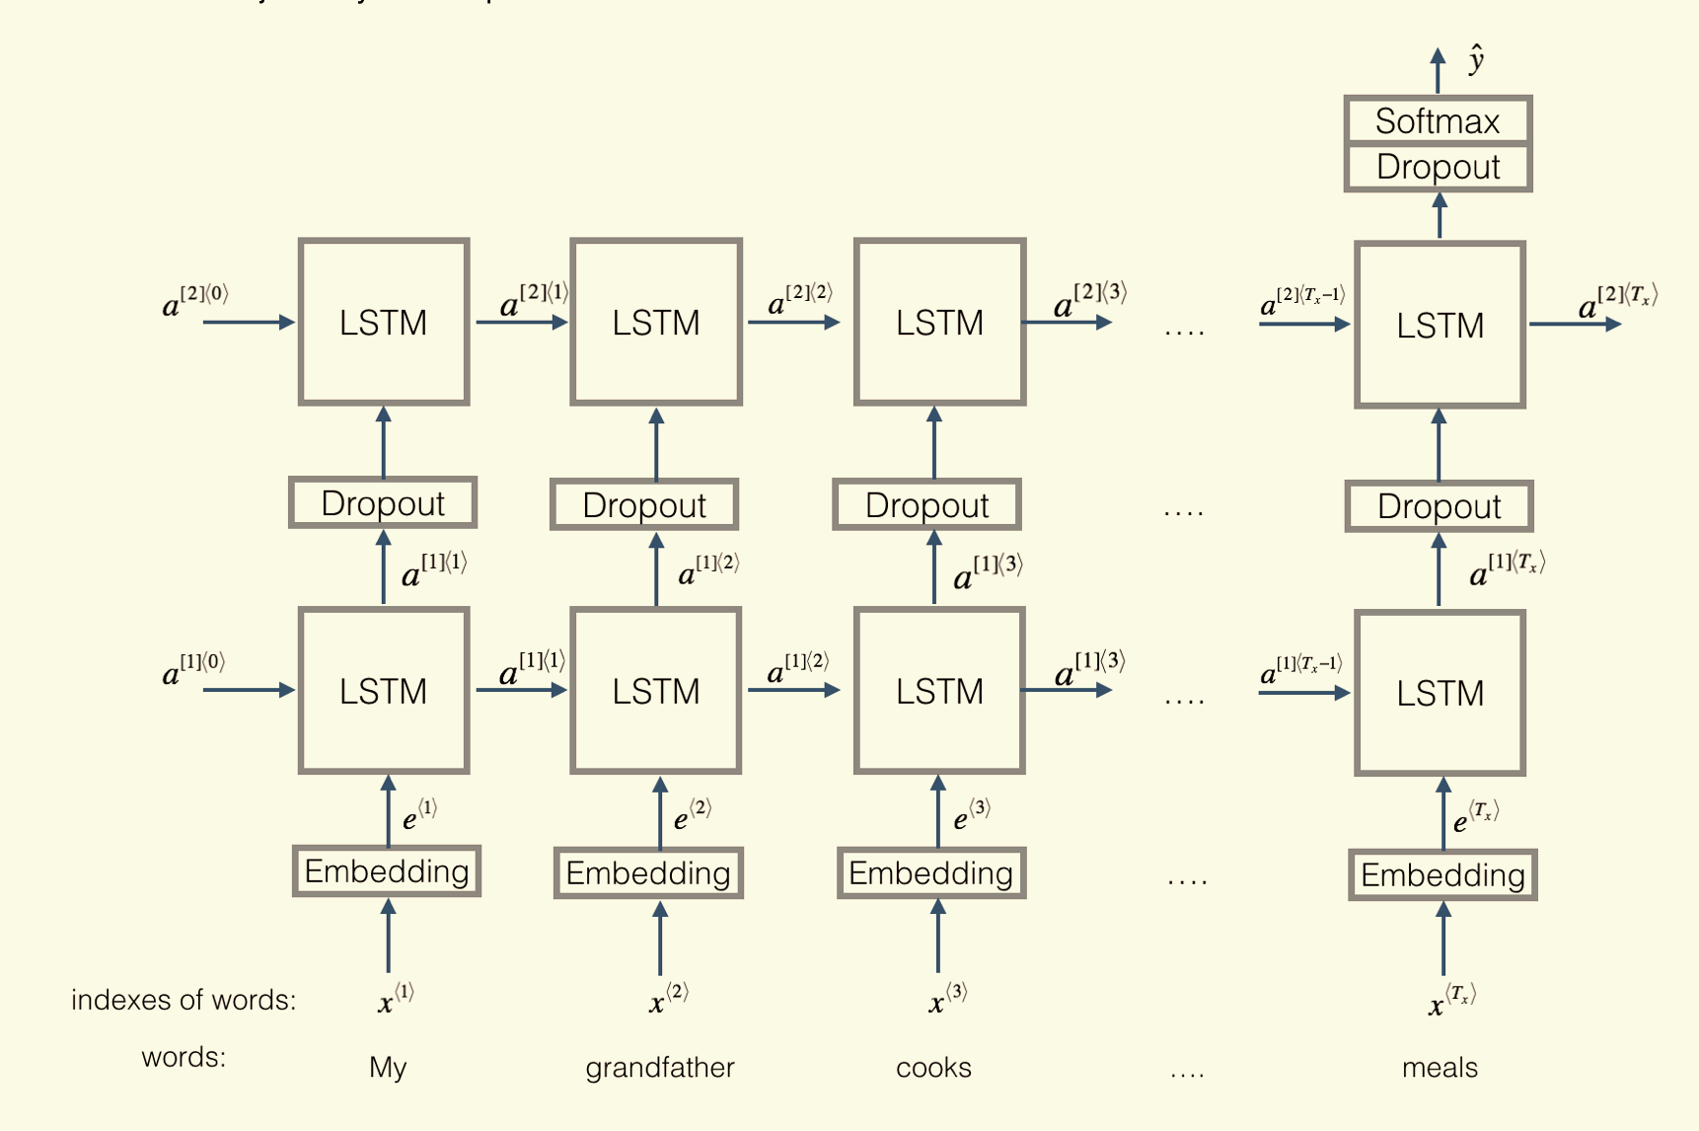
Neural Network Architecture
We will explore a 2-layer LSTM with Dense and Dropout
A two-layer LSTM with Dropout [Coursera]

Slide 11
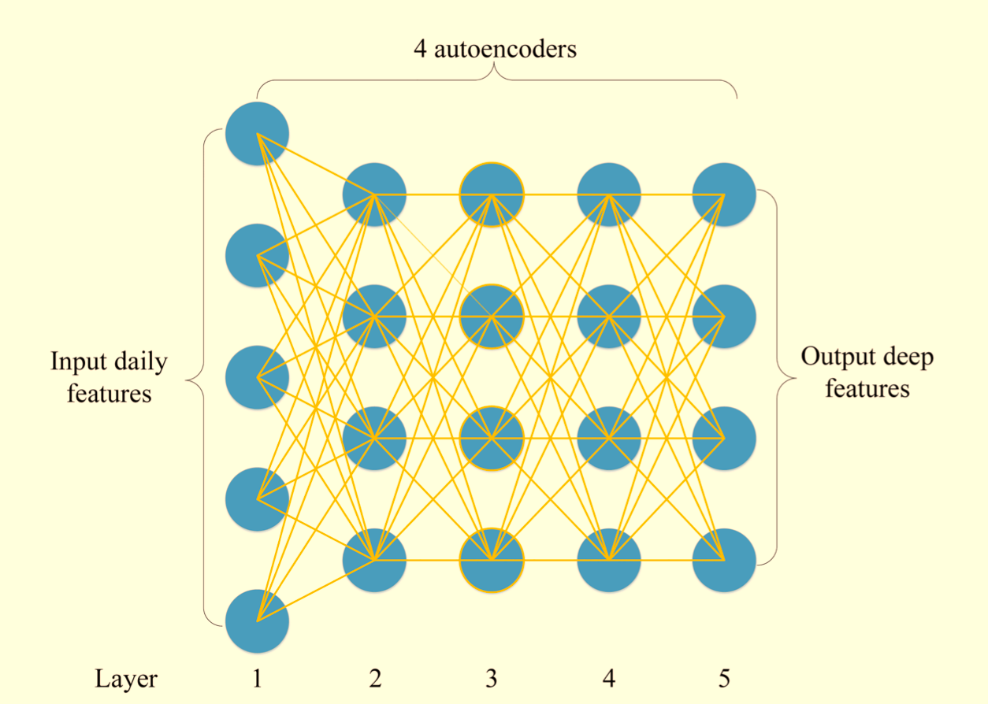
Neural Network Architecture
Embeddings: can be seen as a feature engineering process
Apply autoencoders (pretrained)
Adding more dense layers (to be trained)
A stacked autoencoders trained by 4 autoencoders. [Bao, Yue, Rao, 2017]

Slide 12
Thank you!

Slide 13
References
Sima Siami Namini, Akbar Siami Namin (2018) Forecasting Economics and Financial Time Series: ARIMA vs. LSTM. https://arxiv.org/abs/1803.06386
Bao W, Yue J, Rao Y (2017) A deep learning framework for financial time series using stacked autoencoders and long-short term memory. PLoS ONE 12(7): e0180944.
https://doi.org/10.1371/journal.pone.0180944
Aniruddha Dutta, Saket Kumar and Meheli Basu (2020) A Gated Recurrent Unit Approach to Bitcoin Price Prediction . Journal of risk and financial management. https://arxiv.org/abs/1912.11166

